Slide 1


Slide 2

Notes:
You can say goodbye to cluttered computer screens and stress!! because expedition bot does it all in one go. Making trip planning easy breezy.

Slide 3


OUR SERVICES
1.
Find Flights
2.
Find Accomodations
3.
Plan an Itinerary
Notes:
Our bot is able to find you the cheapest route to your destination, find places to stay in the area, and give you an actual planned out itinerary for every day of your vacation. All you have to do is type in your destination and dates and let Expedition bot do the rest.

Slide 4



Our Competitors
 | Find Flights | Find Accomodations | Plan an Itinerary
Booking.com
Kayak
Trip Advisor
Notes:
Right now, our biggest competitors are booking.com, kayak, and trip advisor. But as we can see, none of them have the capabilities of doing all 3. Meaning you will still need to plan and research a part of your trip.

Slide 5

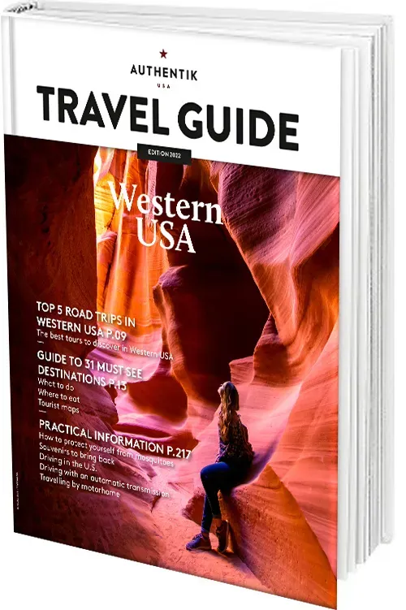
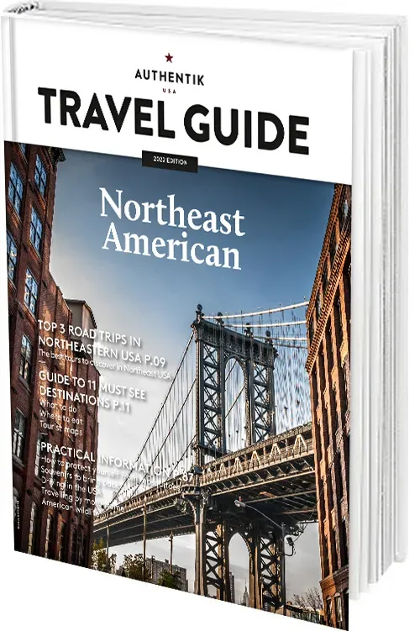

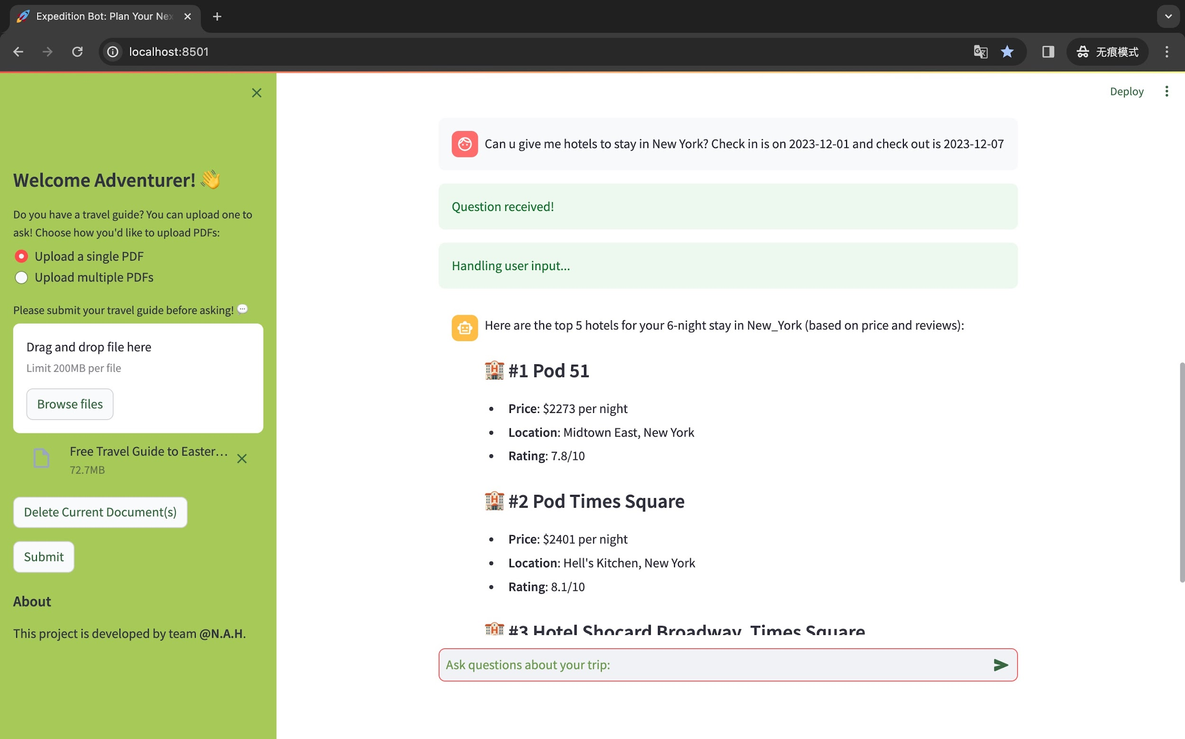


HOW DOES IT WORK?
User Question
Data Sources
Get Embeddings + Extract Images
Travel Guides
Chat large language model API
Flights
Website Scraper
Hotels
Chatbot Interface

Slide 6
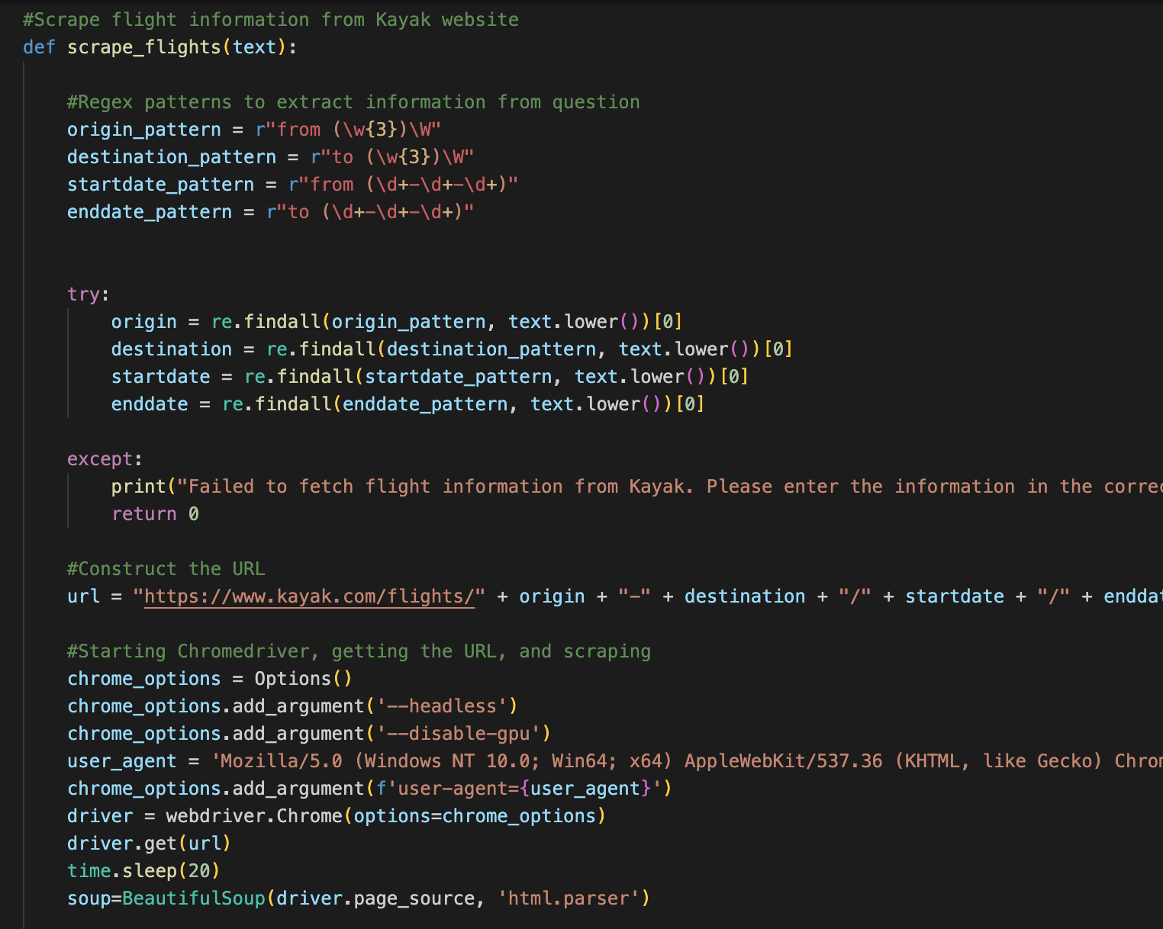


Web Scrape Kayak.com
Can you give me the best flights from LAX to JFK?

Slide 7
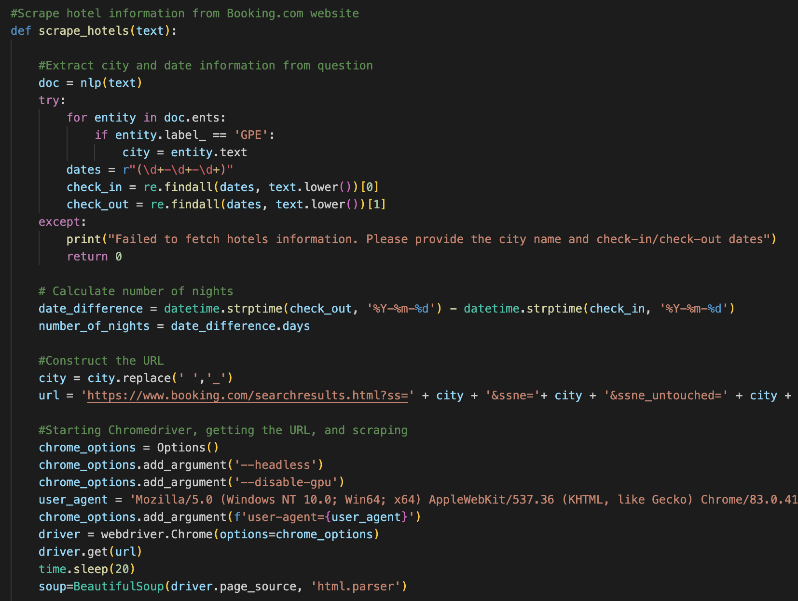



Web Scrape Booking.com
Can you give me hotels to stay in NYC?

Slide 8
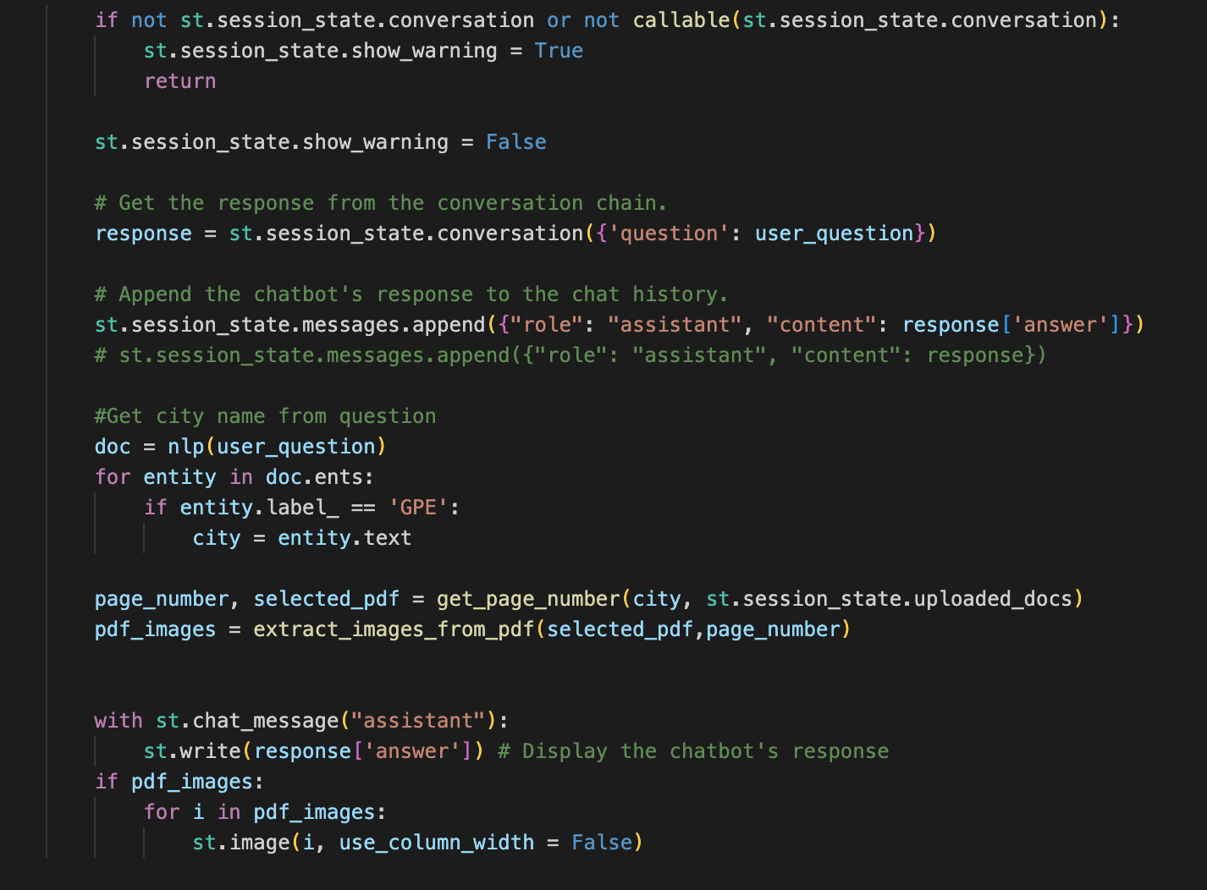


Generate Responses from PDF’s
Can you give me a 3-day itinerary in NYC?

Slide 9


Demo
Notes:
Haley

Slide 10
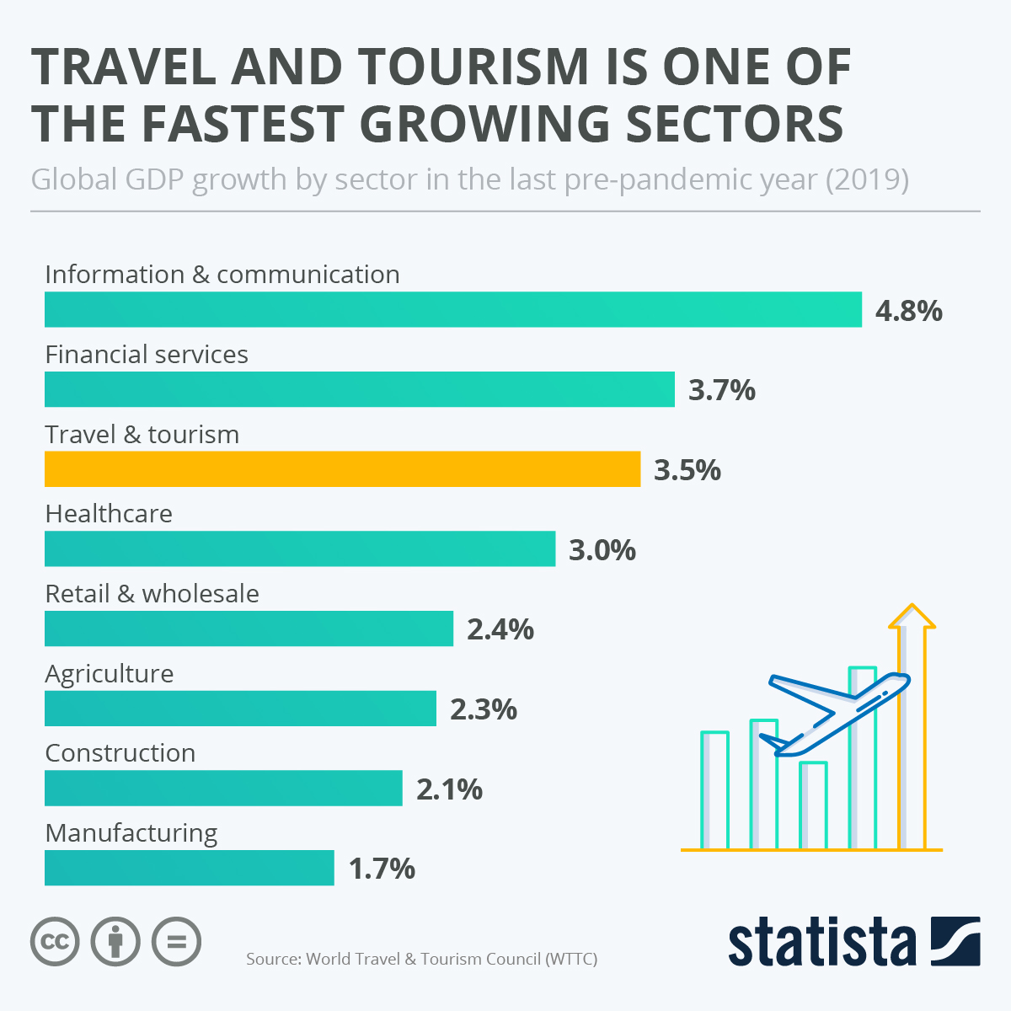

Market Opportunity
There is an increased demand for personalized and efficient trip planning solutions.
Travel agents cost around $75-$150.

Slide 11




Revenue Generation Model
Third party advertising service
Subscription payment by users
($10/month)
Commission from affiliates

Slide 12


Why Invest?
100,000 expected number of users
Subscription of $10/month will yield monthly revenue of
$1 million
Our Solution saves time and money in trip planning
Future expansion to include international trip planning

Slide 13



CONTACT US
TEAM N.A.H
EXPEDITION
BOT
expedition-bot@gmail.com
Nicolette Seina
Anood Alkatheeri
Haoyue Xu
Notes:
MAKE LAST SLIDE
We hope you plan your next trip using Expedition bot!!

